Slide 1

Data Science K Nearest Neighbors
Facultad de Ciencias Económicas
Catedrático: Franz Haidacher

Slide 2
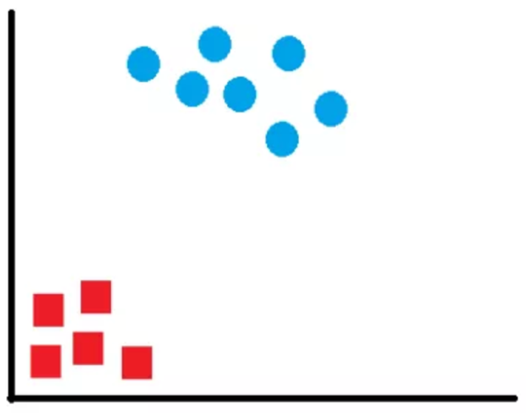
K Nearest Neighbors
?
x

Slide 3
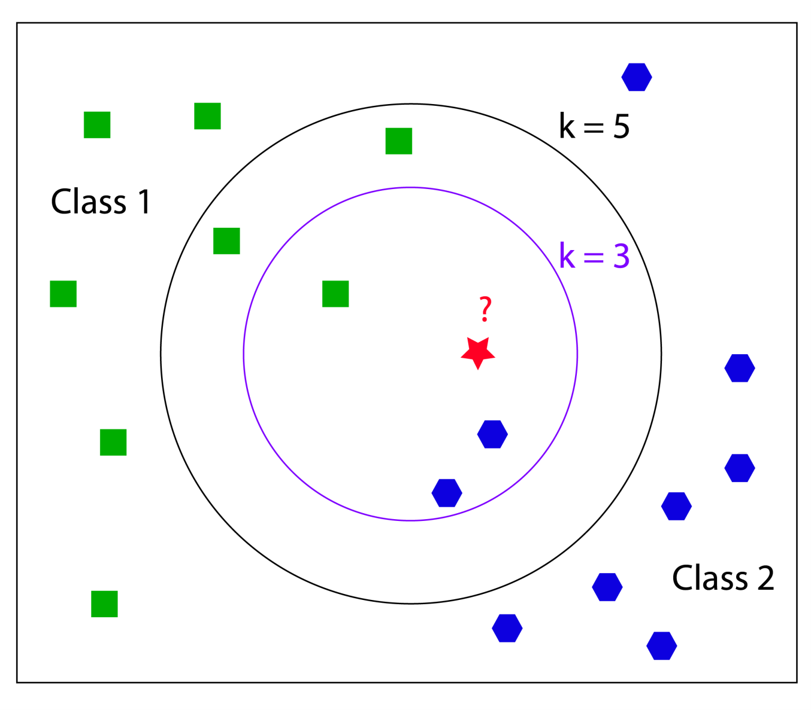
K Nearest Neighbors

Slide 4
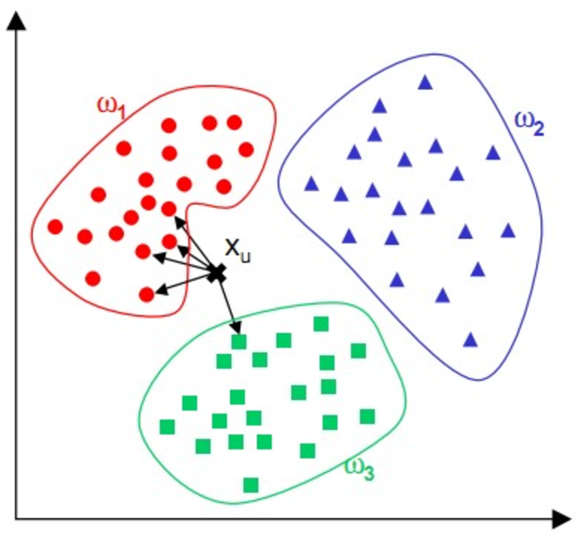
K Nearest Neighbors

Slide 5
K Nearest Neighbors
Step 1: Choose the number K of neighbors
Step 2: Take the K nearest neighbors of the new data point, according to euclidean distance
Step 3: Among these K neighbors, count the number of data points in each category
Step 4: Assign the new data point to the category with the most neighbors

